Slide 1
Singly Linked Lists

Slide 2
Singly Linked List
Singly Linked List Overview
Adding Elements to List
Removing Elements from List

Slide 3
Singly Linked Lists
A singly linked list, in its simplest form, is a collection of nodes that collectively form a linear sequence.
Each node stores a reference to an object that is an element of the sequence, as well as a reference to the next node of the list.

Slide 4
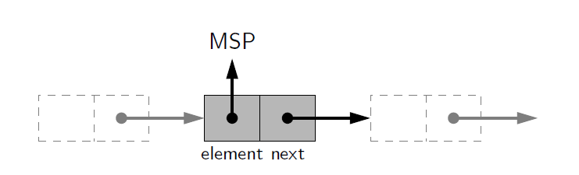
Singly Linked Lists
Airport codes in example figures.

Slide 5
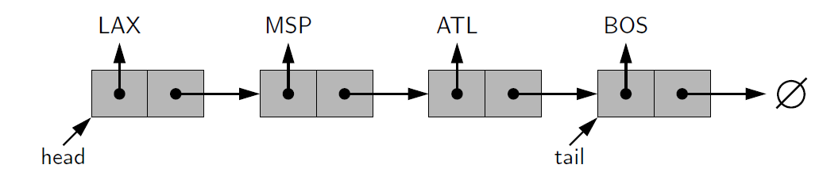
Singly Linked Lists
The list instance maintains a member named head that identifies the first node of the list.
In some applications another member named tail that identifies the last node of the list.

Slide 6
Singly Linked Lists
The first and last node of a linked list are known as the head and tail of the list

Slide 7
Singly Linked Lists
We can identify the tail as the node having None as its next reference.
This process is commonly known as traversing the linked list.

Slide 8
Singly Linked Lists
Because the next reference of a node can be viewed as a link or pointer to another node, the process of traversing a list is also known as link hopping or pointer hopping.

Slide 9
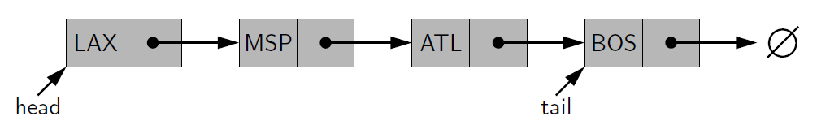
Singly Linked Lists
Each node is represented as a unique object, with that instance storing a reference to its element and a reference to the next node (or None)
Note the change of the diagram for simplicity.

Slide 10
Inserting an Element at the Head of a Singly Linked List
An important property of a linked list is that it does not have a predetermined fixed size
It uses space proportionally to its current number of elements.
To insert a new element at the head of the list:
  We create a new node
  Set its element to the new element
  set its next link to refer to the current head
  then set the list’s head to point to the new node.

Slide 11
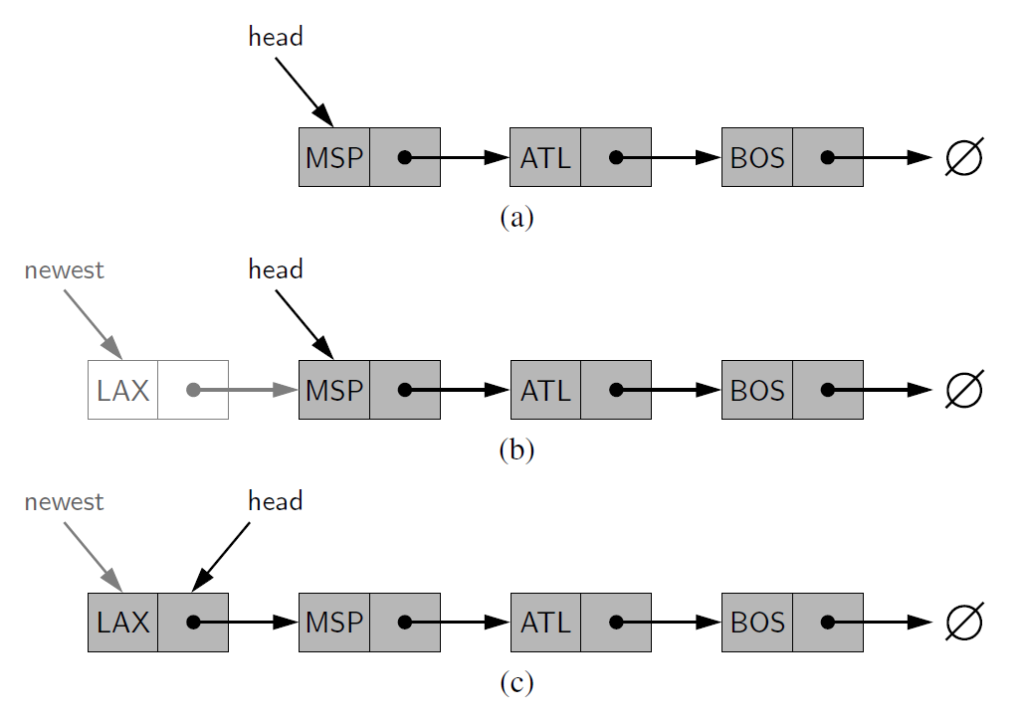
Inserting an Element at the Head of a Singly Linked List
(a) before the insertion
(b) after creation of a new node
(c) after reassignment of the head reference.

Slide 12
Inserting an Element at the Tail of a Singly Linked List
We can also easily insert an element at the tail of the list, provided we keep a reference to the tail node
  Create a new node
  Assign its next reference to None
  Set the next reference of the tail to point to this new node
  Then update the tail reference itself to this new node.

Slide 13
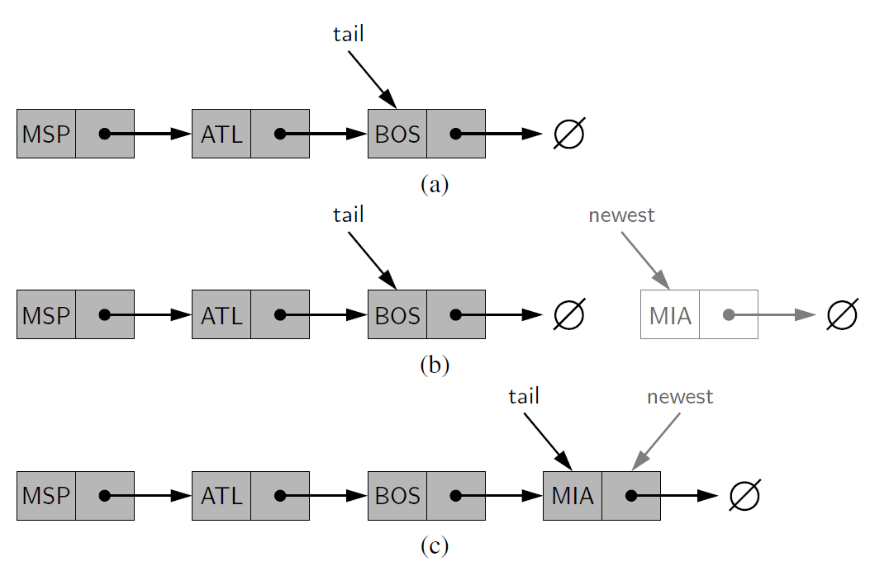
Inserting an Element at the Tail of a Singly Linked List
(a) before the insertion
(b) after creation of a new node
(c) after reassignment of the tail reference.
Note that we must set the next link of the tail in (b) before we assign the tail variable to point to the new node in (c).

Slide 14
Removing an Element from a Singly Linked List
Removing an element from the head of a singly linked list is essentially the reverse operation of inserting a new element at the head.

Slide 15
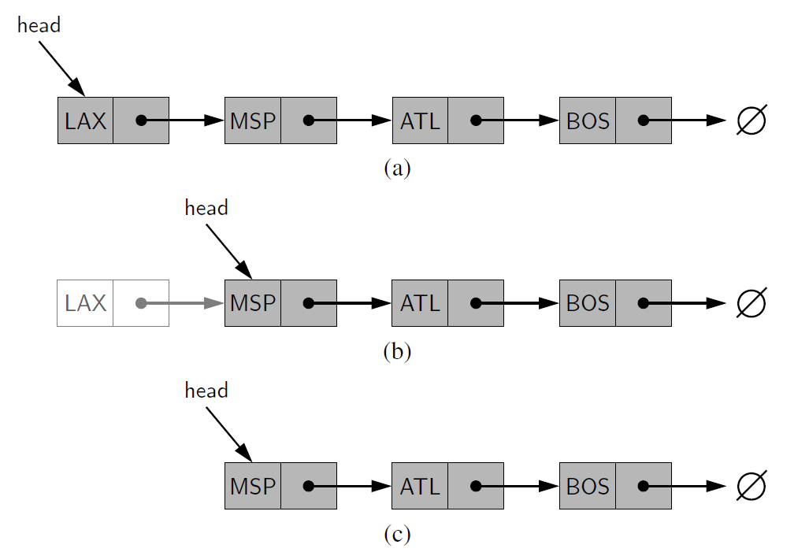
Removing an Element from a Singly Linked List
(a) before the removal
(b) after “linking out” the old head
(c) final configuration

Slide 16
Removing an Element from a Singly Linked List
We cannot easily delete the last node of a singly linked list.
Even if we maintain a tail reference directly to the last node of the list, we must be able to access the node before the last node in order to remove the last node.
But we cannot reach the node before the tail by following next links from the tail.
If we want to support such an operation efficiently, we will need to make our list doubly linked

Slide 17
Removing an Element from a Singly Linked List
We cannot easily delete the last node of a singly linked list.
Even if we maintain a tail reference directly to the last node of the list, we must be able to access the node before the last node in order to remove the last node.
But we cannot reach the node before the tail by following next links from the tail.
If we want to support such an operation efficiently, we will need to make our list doubly linked

Slide 18
Review
We learned about singly linked lists and how to add and remove elements from them.
Up next we will implement a Node class an create a Singly Linked list

